Slide 1
Wolverine World Wide
EPA Updates
Erica Aultz – EPA National Priorities List Coordinator
Superfund & Emergency Management Division
Agenda:
Personnel Update
PFAS Listing Update
House Street Disposal Area Update
Tannery Update

Slide 2
Personnel Changes
Erica Aultz - new Michigan National Priorities List Coordinator
Nuria Muñiz – Section Supervisor, Site Assessment and Grants Section

Slide 3
CERCLA PFAS Update
Final CERCLA Hazardous Substance rule for PFOS and PFOA expected in February 2024
April 2023: Advanced Notice of Proposed Rulemaking for additional PFAS, including GenX was released
  Public comment closed in June 2023
  Notice of Proposed Rulemaking (NPRM) is not known at this time
Neither site has been evaluated for PFAS under the Site Assessment program

Slide 4
Wolverine House Street Disposal Site

Slide 5
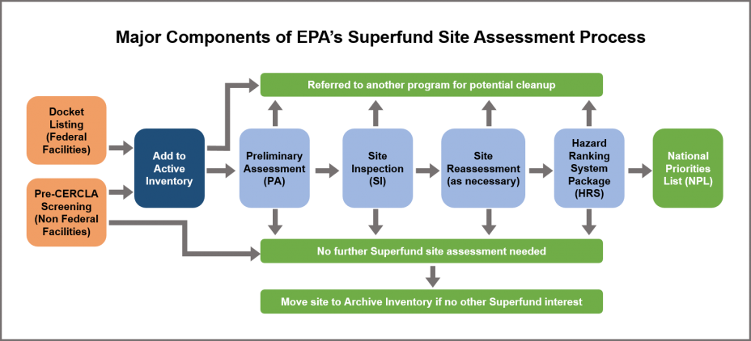
You are here

Slide 6
Wolverine House Street Disposal Site
Preliminary Assessment report is in final stage of review
Approval expected before end of 2023
Final Report will be made available on EPA site webpage
Based on the preliminary evaluation, Site is eligible to move forward to Site Inspection

Slide 7
Wolverine House Street Disposal Site – Next Steps
Next step

Slide 8
Wolverine House Street Disposal Site – Next Steps
Site Inspection involves a field sampling event
  Planning would factor in historical sampling as well as the current activities presently occuring at the site
EPA will work with EGLE as to when to start Site Inspection

Slide 9
Wolverine Tannery
Site Inspection

Slide 10
You are here

Slide 11
Wolverine Tannery
Site Inspection
Draft report is currently under review between EPA and Michigan EGLE
Planned completion date of March 31, 2024
Upon completion, EPA will add report to the site webpage
Preliminary evaluation shows site can move forward in the process

Slide 12
Wolverine Tannery – Next Steps
Next step

Slide 13
Wolverine Tannery – Next Steps
EPA and EGLE will work together to plan start of next report, also known as an Expanded Site Inspection
Another field sampling event would occur
The subsequent steps, Hazard Ranking System Package and Proposal to the NPL are done with support from the State of Michigan

Slide 14
Questions?
Comments?

